Slide 1
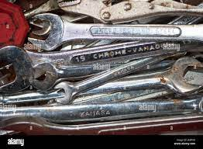
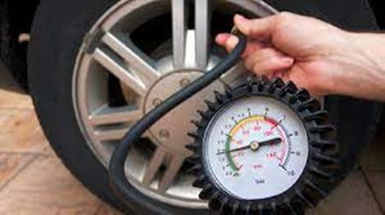
Mechanical Maintenance
1.Spanners
1. Combination Spanner 2. Ring Spanner 3. Open Ended Spanner
-It is used for loosening and tightening of bolts and nuts.
2.Tyre Pressure Gauge
-To inflate air into the tyres.

Slide 2
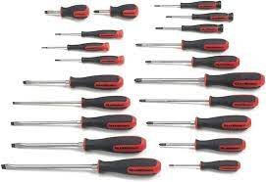
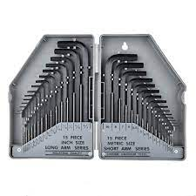
3.Screwdrivers
-It is used for loosening and tightening of screws.
-It is used for loosening and tightening of bolts & nuts.
4.Allen keys
-It is used for loosening and tightening of bolts & nuts.

Slide 3
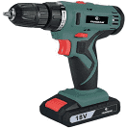
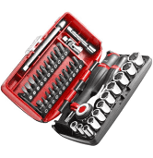
5.Cordless drill
-It is used for loosening and tightening of screws.
-It is used for loosening and tightening of bolts & nuts.
6.Sockets
-It is used for loosening and tightening of screws.
-It is used for loosening and tightening of bolts & nuts.

Slide 4
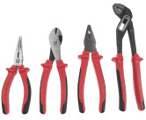
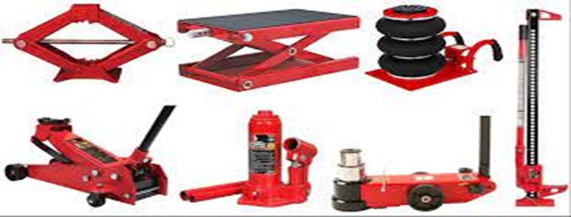
7.Pliers
1. Long Nose Plier 2. Side Cutter. Combination Plier 4. Water Pump Plier
-They are used as cutting tools, removing and replacing of clamps etc.
8. Jacks
Top : 1. Scissor Jack 2. Rolling Trolley 3. Pneumatic Jack
Bottom : 1. Floor or Trolley Jack 2. Bottle Jack 3.Pneumatic Trolley 4. Farm Jack
- To lift heavy loads.

Slide 5
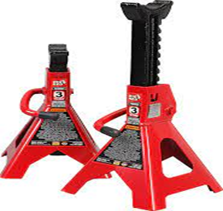
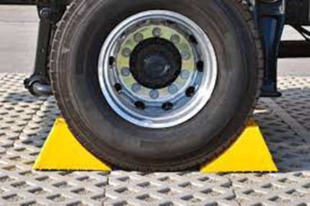
9.Jack Stand
- To hold a vehicle in place.
10.Tyre blocks
- To assist in levelling.

Slide 6
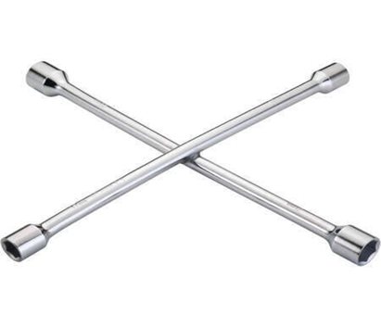

11.Wheel spanner
- For loosening and fastening of bolts and nuts.
12.Triangle Reflector
- It prevents coolant from freezing.
Video :
https://youtu.be/t1t-JGnC10I?si=BGGPH9rGz5S6hD7v
Feedback : Activity

Slide 7

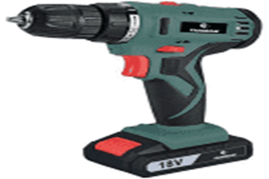
Kwa Thema Skills School
Subject : Maintenance Marks : 12
Grade : Year 1 Time : 30 mins
Date : / / 2024
Question:1
1.Identify the following tools and equipments.
1.1 ________________ 1.2 _________________
1.3 _________________ 1.4 _________________
1.9 _________________________ 1.10 _________________________

Slide 8
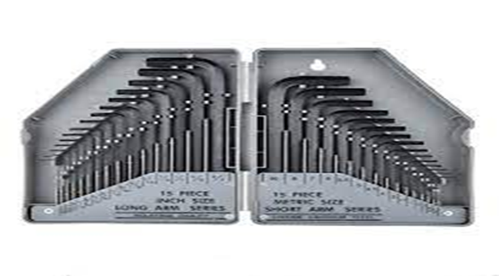
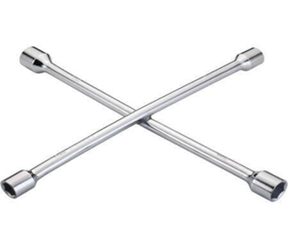


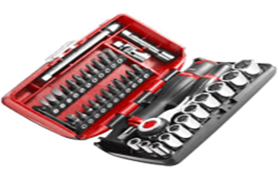
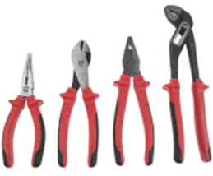
1.5 ________________ 1.6 __________________
1.7 ________________ 1.8 __________________
1.9 ________________ 1.10 __________________
1.11 ________________ 1.12 __________________

Slide 9
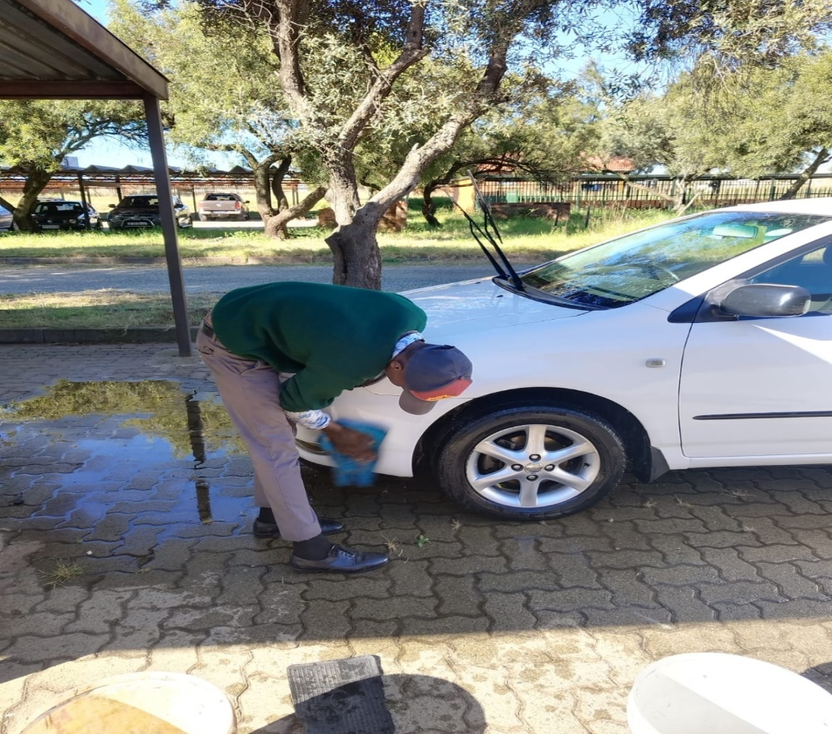
Feedback : Activity
(Practical Lesson or Project)
Wash a car by hand

